Slide 1
Chapter 5

Slide 2
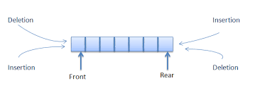
Topics
Stacks
Queues
Deque
Adapters and the Adapter Design Pattern

Slide 3
Stacks

Slide 4

Stacks
A data structure where addition and deletion of elements take place only at one end, called the top of the stack
A last in first out (LIFO) data structure
In a cafeteria the second tray, in a stack of trays, can be removed only if the first tray is removed

Slide 5

Applications of Stacks
Direct applications
Page-visited history in a Web browser
Undo sequence in a text editor
Chain of method calls in the C++ run-time system
Indirect applications
Auxiliary data structure for algorithms
Component of other data structures

Slide 6
Abstract Data Types (ADTs)
An abstract data type (ADT) is an abstraction of a data structure
An ADT specifies:
Data stored
Operations on the data
Error conditions associated with operations
Example: ADT modeling a simple stock trading system
The data stored are buy/sell orders
The operations supported are
order buy(stock, shares, price)
order sell(stock, shares, price)
void cancel(order)
Error conditions:
Buy/sell a nonexistent stock
Cancel a nonexistent order

Slide 7
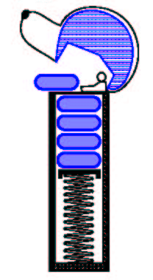
The Stack ADT
PEZ dispenser
The Stack ADT stores arbitrary objects
Insertions and deletions follow the last-in first-out scheme
Think of a spring-loaded plate dispenser
Main stack operations:
push(object): inserts an element
object pop(): removes and returns the last inserted element
Auxiliary stack operations:
object top(): returns the last inserted element without removing it
integer size(): returns the number of elements stored
boolean isEmpty(): indicates whether no elements are stored

Slide 8
C++ Run-Time Stack
The C++ run-time system keeps track of the chain of active functions with a stack
When a function is called, the system pushes on the stack a frame containing
Local variables and return value
Program counter, keeping track of the statement being executed
When the function ends, its frame is popped from the stack and control is passed to the function on top of the stack
Allows for recursion
main() { int i = 5; foo(i); }
foo(int j) { int k; k = j+1; bar(k); }
bar(int m) { … }
bar
PC = 1 m = 6
foo
PC = 3 j = 5
k = 6
main
PC = 2 i = 5

Slide 9
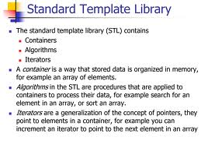
Standard Template Library (STL) “Created to Reuse Code”

Slide 10
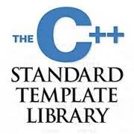
STL Template Headers
<vector> - defines a template class for implementing a container (resizable array)
<stack> - container with the last-in, first-out access
<queue> - container with the first-in, first-out access
<deque> - double ended queue
<list> - doubly linked list
<priority_queue> - queue order by value
<set> - set
<map> - associative array (dictionary)
<iterator> - defines a template for defining manipulating iterators

Slide 11
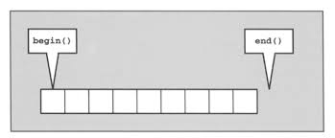
STL iterators
iterator
Generalized pointer for keeping track of the beginning, ending, and other positions of a data structure
Is a class object that can point at an element of a container by storing its memory address
Has built in operations that can access the value stored at a location
iterator++ // move to the next element
iterator-- // move to the previous element
*iterator // access the value at the position pointed to by iterator

Slide 12

The STL Stack
STL provides an implementation of a stack
Based on the STL vector class
Space is dynamically managed by the STL
Need to #include <stack>
Part of the namepsace std
To create a stack of doubles:
stack <double> myStack
http://www.cplusplus.com/reference/stack/stack/

Slide 13
The STL Stack Methods
size() :
Returns the number elements in the stack
empty() :
Returns true if the stack is empty else false
push(e) :
Push e onto the top of the stack
pop() :
Pop the element at the top of the stack
top() :
Returns a reference to the element at the top of the stack
An exception is not thrown resulting from a pop() or top() to an empty stack
Programmer’s responsibility
See example stack1.cpp

Slide 14
Array-Based Stack
A simple way of implementing the Stack ADT uses an array
One adds elements from left to right
A variable keeps track of the index of the top element
…
S
0
1
2
t
N - 1

Slide 15

Implementing a Stack as an Array
template <class Type>
class stackType
{
public:
bool isEmptyStack();
bool isFullStack();
void destroyStack();
void push(const Type& newItem);
void pop(Type& poppedItem);
stackType(int stackSize = 100);
stackType(const stackType<Type>& otherStack);
~stackType();
private:
int maxStackSize;//variable to store the maximum stack size
int top;//variable to point to the top of the stack
Type *list; //pointer to the array that holds }
See example stack2.cpp

Slide 16
Array-based Stack Methods
Algorithm size()
return t + 1
Algorithm pop()
if empty() then
throw StackEmpty
else
t ← t − 1
return S[t + 1]
Algorithm isEmpty()
return (t < 0)
Algorithm top()
if isEmpty then
throw EmptyStackException
return S[t]

Slide 17
Array-based Stack (2)
The array storing the stack elements may become full
A push operation will then throw a StackFull exception
Limitation of the array-based implementation
Not intrinsic to the Stack ADT
Algorithm push(o)
if t = S.size() − 1 then
throw StackFull
else
t ← t + 1
S[t] ← o
…
S
0
1
2
t

Slide 18
Performance and Limitations
Performance
Let n be the number of elements in the stack
The space used is O(n)
Each operation runs in time O(1)
Limitations
The maximum size of the stack must be defined a priori and cannot be changed
Trying to push a new element into a full stack causes an implementation-specific exception
Method | Time
size() | O(1)
isEmpty() | O(1)
top() | O(1)
push() | O(1)
pop() | O(1)

Slide 19
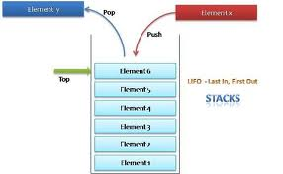
Array-based Stack Drawbacks
A fixed upper bound must be assumed
Can waste memory or
Not enough memory allocated

Slide 20
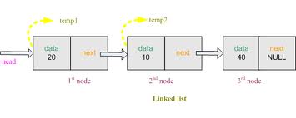
Definition of Linked Nodes
template <class Type>
struct nodeType
{
Type info;
nodeType<Type> *link;
};

Slide 21
Stack with a Singly Linked List
One can implement a stack with a singly linked list
The top element is stored at the first node of the list
It takes O(n) time to allocate space
Each operation of the Stack ADT takes O(1) time
nodes
t
∅
elements

Slide 22

Linked Implementation of Stacks
Because an array size is fixed, in the array (linear) representation of a stack, only a fixed number of elements can be pushed onto the stack
If in a program the number of elements to be pushed exceeds the size of the array, the program may terminate in an error
In a linked representation top is used to locate the top element in the stack
When using arrays, top gives the index of the array

Slide 23

Definition of Stack using a Linked List
template<class Type>
class linkedStackType
{
public:
bool isEmptyStack();
bool isFullStack();
void push(const Type& newItem);
void pop(Type& poppedElement);
void destroyStack();
linkedStackType();
linkedStackType(const linkedStackType<Type>& otherStack);
~linkedStackType();
private:
nodeType<Type> *top; //pointer to the stack
}; (Author has another implementation)

Slide 24
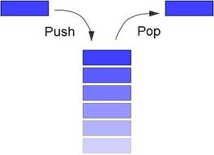
Pop Function
template<class Type>
void linkedStackType<Type>::pop(Type& poppedElement)
{
nodeType<Type> *temp; //pointer to deallocate memory
poppedElement = top->info; //copy the top element
temp = top; //set temp to point to the top node
top = top->link; //advance top to the next node
delete temp; //delete the top node
}//end pop
See example stack3.cpp

Slide 25
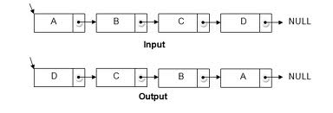
Reversing an Array (code Fragment 5.10)
template <typename E>
void reverse(vector<E>& V) { // reverse a vector
ArrayStack<E> S(V.size());
for (int i = 0; i < V.size(); i++) // push elements onto stack
S.push(V[i]);
for (int i = 0; i < V.size(); i++) { // pop them in reverse order
V[i] = S.top(); S.pop();
}
}

Slide 26
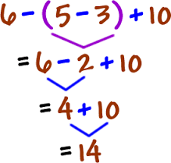
An Application of Stacks - Parentheses Matching
Each “(”, “{”, or “[” must be paired with a matching “)”, “}”, or “[”
correct: ( )(( )){([( )])}
incorrect: ((( )(( )){([( )])}
incorrect: )(( )){([( )])}
incorrect: ({[ ])}
incorrect: (

Slide 27

An Application of Stacks - Parentheses Matching Algorithm
Each time an opening symbol is encountered, the symbol is pushed on the stack
Each time a closing symbol is encountered, the symbol is popped off the stack (assuming it is not empty)
Ensure the symbols are of the corresponding type
If the stack is empty after the sequence is processed, then all the symbols match

Slide 28

Parentheses Matching Algorithm
Algorithm ParenMatch(X,n):
Input: An array X of n tokens, each of which is either a grouping symbol, a
variable, an arithmetic operator, or a number
Output: true if and only if all the grouping symbols in X match
Let S be an empty stack
for i=0 to n-1 do
if X[i] is an opening grouping symbol then
S.push(X[i])
else if X[i] is a closing grouping symbol then
if S.isEmpty() then
return false {nothing to match with}
if S.pop() does not match the type of X[i] then
return false {wrong type}
if S.isEmpty() then
return true {every symbol matched}
else
return false {some symbols were never matched}

Slide 29
HTML Tag Matching
For fully-correct HTML, each <name> should pair with a matching </name>
<body>
<center >
<h1> The Little Boat </h1>
</center>
<p> The storm tossed the little
boat like a cheap sneaker in an
old washing machine. The three
drunken fishermen were used to
such treatment, of course, but
not the tree salesman, who even as
a stowaway now felt that he
had overpaid for the voyage. </p>
<ol>
<li> Will the salesman die? </li>
<li> What color is the boat? </li>
<li> And what about Naomi? </li>
</ol>
</body>
The Little Boat
The storm tossed the little boat
like a cheap sneaker in an old
washing machine. The three
drunken fishermen were used to
such treatment, of course, but not
the tree salesman, who even as
a stowaway now felt that he had
overpaid for the voyage.
1. Will the salesman die?
2. What color is the boat?
3. And what about Naomi?
(see code fragments 5.12 – 5.14)

Slide 30
Queues

Slide 31

Queues
A queue is a data structure in which elements are added at one end, called the rear, and deleted from the other end, called the front
A first in first out (FIFO) data structure
The middle elements of the queue are inaccessible
The rear of the queue is accessed whenever a new element is added to the queue
The front of the queue is accessed whenever an element is deleted from the queue

Slide 32

Applications of Queues
Consider a line of customers in a bank, where customers are waiting either to withdraw/deposit money or for some other business
Each new customer gets in the line at the rear and whenever a teller is ready for a new customer, the customer at the front of the line is served
Direct applications
Waiting lists, bureaucracy
Access to shared resources (e.g., printer)
Multiprogramming
Indirect applications
Auxiliary data structure for algorithms
Component of other data structures

Slide 33

The STL Queue
STL provides an implementation of a queue
Based on the STL vector class
Space is dynamically managed by the STL
Need to #include <queue>
Part of the namepsace std
To create a queue of doubles:
stack <double> myQueue
http://www.cplusplus.com/reference/queue/queue/

Slide 34

The STL Queue Methods
size() :
Returns the number elements in the queue
empty() :
Returns true if the queue is empty else false
push(e) :
Enqueue e at the rear of the queue
pop() :
Dequeue the element at the front of the queue
front():
Returns a reference to the element at the queue’s front
back():
Returns a reference to the element at the queue’s rear
An exception is not thrown resulting from a front(), back() or pop() to an empty queue
Programmer’s responsibility
See example queue1.cpp

Slide 35

Array-based Queue
If Q[0] is always at the front of the array
One would have to move all the elements forward each time a dequeue operation is performed
O(n) – not very efficient

Slide 36
Another Approach for an Array-based Queue
normal configuration
Q
0
1
2
f
r
What is the problem using the normal configuration?

Slide 37
Circular Array-based Queue
More efficient to use an array in a circular fashion
Goal is O(1) for a enqueue and dequeue
Two variables keep track of the front and rear
f : is the index of the front element
r: is the index immediately past the rear element
n: is the current number of elements
Initially n = f = r =0
circular array
Q
0
1
2
r
f

Slide 38
Queue Operations
We use the modulo operator (remainder of division)
Each time f or r is incremented, one computes (f+1) mod N or (r+1) mod N
Q
0
1
2
f
r
Q
0
1
2
r
f

Slide 39
Queue Operations
Use n to determine size and emptiness
Algorithm size()
return n
Algorithm empty()
return (n = 0)
Q
0
1
2
f
r
Q
0
1
2
r
f

Slide 40
enqueue
Algorithm enqueue(e)
if size() = N then
throw FullQueueException
else
Q[r] ← e
r ← (r + 1) mod N
n = n + 1
Operation enqueue throws an exception if the array is full
This exception is implementation-dependent
Q
0
1
2
f
r
Q
0
1
2
r
f

Slide 41
dequeue
Operation dequeue throws an exception if the queue is empty
This exception is specified in the queue ADT
Algorithm dequeue()
if isEmpty() then
throw EmptyQueueException
else
f ← (f + 1) mod N
n = n -1
Q
0
1
2
f
r
Q
0
1
2
r
f

Slide 42
One More Queue Method
All operations execute in O(1) time
Algorithm front()
if empty() then
throw EmptyQueueException
return Q[f]

Slide 43
Circular Queue Implementation
template<class Type>
class queueType
{
public:
const queueType<Type>& operator=(const queueType<Type>&);
// overload the assignment operator
void initializeQueue();
void destroyQueue();
int isEmptyQueue();
int isFullQueue();
void addQueue(Type queueElement);
void deQueue(Type& deqElement);
queueType(int queueSize = 100);
queueType(const queueType<Type>& otherQueue);
// copy constructor
~queueType();
//destructor
private:
int maxQueueSize;
int count;
int front;
int rear;
Type *list; //pointer to the array that holds the queue elements
}; See example queue2.cpp

Slide 44
The Queue ADT
The Queue ADT stores arbitrary objects
Insertions and deletions follow the first-in first-out scheme
Insertions are at the rear of the queue and removals are at the front of the queue
Main queue operations:
enqueue(object): inserts an element at the end of the queue
object dequeue(): removes and returns the element at the front of the queue
Auxiliary queue operations:
object front(): returns the element at the front without removing it
integer size(): returns the number of elements stored
boolean isEmpty(): indicates whether no elements are stored
Exceptions
Attempting the execution of dequeue or front on an empty queue throws an EmptyQueueException

Slide 45
Queue Interface in C++
template <typename E>
class Queue {
public:
int size() const;
bool empty() const;
const E& front() const
throw(QueueEmpty);
void enqueue (const E& e);
void dequeue()
throw(QueueEmpty);};
5.15
C++ interface corresponding to the Queue ADT
Requires the def-inition of exception QueueEmpty
No corresponding built-in C++ class

Slide 46

Empty Queue Exception
// class QueueEmpty : public RuntimeException { public: QueueEmpty(const string& err) : RuntimeException(err) { } };

Slide 47
Queue Example
Operation Output front ←Q ← rear
enqueue(5) – (5)
enqueue(3) – (5, 3)
dequeue() 5 (3)
enqueue(7) – (3, 7)
dequeue() 3 (7)
front() 7 (7)
dequeue() 7 ()
dequeue() “error” ()
isEmpty() true ()
enqueue(9) – (9)
enqueue(7) – (9, 7)
size() 2 (9, 7)
enqueue(3) – (9, 7, 3)
enqueue(5) – (9, 7, 3, 5)
dequeue() 9 (7, 3, 5)

Slide 48
Queue with a Singly Linked List
We might implement a queue with a singly linked list
The front element is stored at the first node
The rear element is stored at the last node
Not efficient since it provides access to only one side of the list (using only one pointer)
nodes
f
∅
elements

Slide 49

Circularly Link List
A linked list without head or tail
Traversal means circle through all nodes
Singly linked list where the last node points to the first node
Cursor allows one to have a place to start
Keeps track of where traversing commenced
Methods
Add node: insert after the cursor
Remove node: remove node immediately after the cursor
Advance node: advance the cursor to the next node

Slide 50
Queue as a Circularly Link List
Cursor - points to a node in the list
cursor
MSP
ATL
BOS
MIA

Slide 51
Circularly Linked Lists Methods (1)
front ()
Returns the element referenced by the cursor (front of the queue)
Returns an error if the list is empty
back ()
Returns the element immediately after the cursor (rear of the queue)
Returns an error if the list is empty
advance ()
Advance the cursor to the next in the list
Returns an error if the list is empty

Slide 52
Circularly Linked Lists Methods (2)
add (e)
Insert a new node with element e immediately after the cursor
If the list is empty, then this node becomes the cursor and its next pointer points to itself
remove ()
Remove the node immediately after the cursor
Not the cursor itself unless it is the only node
If the list becomes empty, the cursor is set to null

Slide 53
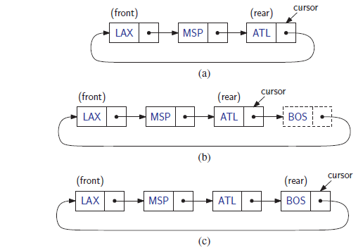
Adding an Element (enqueue)
First invoke the add() method which inserts a new element after the cursor at the rear of the queue
Then invoke the advance() method to advance the cursor to the new element making it the rear

Slide 54
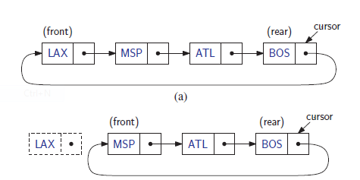
Removing an Element (dequeue)
Invoke the remove() method which removes the node after the cursor which is the front of the queue

Slide 55
Implementing a Circular Queue
typedef string Elem; // queue element type
class LinkedQueue { // queue as doubly linked list
public:
LinkedQueue(); // constructor
int size() const; // number of items in the queue
bool empty() const; // is the queue empty?
const Elem& front() const throw(QueueEmpty); // the front element
void enqueue(const Elem& e); // enqueue element at rear
void dequeue() throw(QueueEmpty); // dequeue element at front
private: // member data
CircleList C; // circular list of elements
int n; // number of elements
};
see 5.18 – 5.20

Slide 56
Another Implement of a Queue using a Linked List
We can implement a queue with a singly linked list
The front element is stored at the first node
The rear element is stored at the last node
The space used is O(n) and each operation of the Queue ADT takes O(1) time
r
nodes
f
∅
elements

Slide 57
Linked Implementation of Queues
Two pointers, front and rear, are used to maintain a queue
//Definition of the node
template <class Type>
struct nodeType
{
Type info;
nodeType<Type> *link;
};

Slide 58
Queue as a Linked List
template<class Type>
class linkedQueueType
{
public:
const linkedQueueType<Type>& operator (const linkedQueueType<Type>&);
bool isEmptyQueue();
bool isFullQueue();
void destroyQueue();
void initializeQueue();
void addQueue(const Type& newElement);
void deQueue(Type& deqElement);
linkedQueueType (); //default constructor
linkedQueueType(const linkedQueueType<Type>& otherQueue);
~linkedQueueType(); //destructor
private:
nodeType<Type> *front;
nodeType<Type> *rear;
};

Slide 59
Queue Operations
Queue Operations
initializeQueue
destroyQueue
isEmptyQueue
isFullQueue
addQueue
Operation that adds an element to the queue
deQueue
Operation removes the front element from the queue and stores the front element

Slide 60
addQueue
template<class Type>
void linkedQueueType<Type>::addQueue (const Type& newElement)
{
nodeType<Type> *newNode;
newNode = new nodeType<Type>; //create the node
newNode->info = newElement; //store the info
newNode->link = NULL;
if(front == NULL) //if initially the queue is empty
{
front = newNode;
rear = newNode;
}
else //add newNode at the end
{
rear->link = newNode;
rear = rear->link;
}
}//end addQueue

Slide 61
DeQueue
template<class Type>
void linkedQueueType<Type>::deQueue(Type& deqElement)
{
nodeType<Type> *temp;
deqElement = front->info;
temp = front;
front = front->link;
delete temp; //delete the first node
if(front == NULL) //if after deletion the queue is empty
rear = NULL; //set rear to NULL
}//end deQueue
See example queue3.cpp

Slide 62
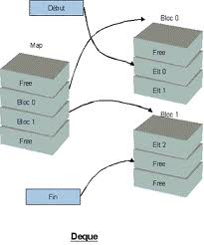
Double-Ended Queues
A queue like structure that supports insertion and deletion at both the front and rear of the queue
Deque – pronounced “deck” (like a deck of cards)

Slide 63
An Application of a Deque
When modeling any kind of real-world waiting line entities (people, cars, etc.) arrive with a certain frequency to the end of the line and are serviced at a different frequency at the beginning of the line
While waiting some entities may decide to leave the line
The point is that one needs "fast access" to insert/deletes at both ends of the line
Deque

Slide 64

A-Steal Job Scheduling Algorithm
This algorithm (used by Intel for parallel programming) implements task scheduling for several processors
A separate deque with threads to be executed is maintained for each processor
To execute the next thread, the processor gets the first element from the deque (using the "remove first element" deque operation)
If the current thread forks, it is put back to the front of the deque ("insert element at front") and a new thread is executed
When one of the processors finishes execution of its own threads (i.e. its deque is empty), it can "steal" a thread from another processor: it gets the last element from the deque of another processor ("remove last element") and executes it

Slide 65
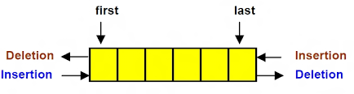
The Deque ADT Methods (1)
InsertFront (e): inserts a new element e at the beginning of the deque
InsertBack (e): inserts a new element e at the end of the deque
EraseFront (): Removes the first element of the deque; an error occurs if the deque is empty
EraseBack ():: Removes the last element of the deque; an error occurs if the deque is empty

Slide 66
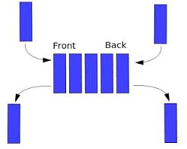
The Deque ADT Methods (2)
front(): Returns the first element of the deque; an error occurs if the deque is empty
back(): Returns the last element of the deque; an error occurs if the deque is empty
size(): Returns the number of elements in the deque
empty(): Returns true if the deque is empty otherwise false

Slide 67
Deque Example
Operation Output Deque
insertFront(3) – (3)
insertFront(5) – (5, 3)
front () 5 (5,3)
eraseFront() - (3)
insertBack(7) - (3,7)
back() 7 (3,7)
eraseFront() - (7)
eraseBack() - ()

Slide 68
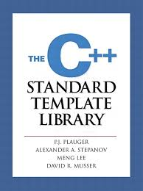
The STL Deque
<include <deque>
Deque <type> myDeque;
http://www.cplusplus.com/reference/deque/deque/

Slide 69

The STL Deque Methods (1)
size()
Returns the number elements in the deque
empty()
Returns true if the deque is empty else false
Push_front(e)
Inserts e at the beginning of the deque
Push_back(e)
Inserts e at the end of the deque
Pop_front()
Removes the first element of the deque

Slide 70
The STL Deque Methods (2)
Pop_back() :
Removes the last element of the deque
front()
Returns a reference to the element at the deque’s first element
back()
Returns a reference to the element at the deque’s last element
An exception is not thrown resulting from a front(), back(), push_front, or push_back() to an empty deque
Programmer’s responsibility
See example deque1.cpp

Slide 71
Implementing a Deque with a Doubly Linked List
The DlinkedList class is used (code fragment 3.23) within the LinkedDeque implementation
The front of the deque is at the head of the linked list
The rear of the deque is at the tail of the linked list
next
header
JFK
PVD
SFO
trailer
previous

Slide 72
DLinkedList Implementation
class DLinkedList { // doubly linked list
public:
DLinkedList(); // constructor
~DLinkedList(); // destructor
bool empty() const; // is list empty?
const Elem& front() const; // get front element
const Elem& back() const; // get back element
void addFront(const Elem& e); // add to front of list
void addBack(const Elem& e); // add to back of list
void removeFront(); // remove from front
void removeBack(); // remove from back
private: // local type definitions
DNode* header; // list sentinels
DNode* trailer;
protected: // local utilities
void add(DNode* v, const Elem& e); // insert new node before v
void remove(DNode* v); // remove node v
};
3.23

Slide 73
Deque Implementation
typedef string Elem; // deque element type
class LinkedDeque { // deque as doubly linked list
public:
LinkedDeque(); // constructor
int size() const; // number of items in the deque
bool empty() const; // is the deque empty?
const Elem& front() const throw(DequeEmpty); // the first element
const Elem& back() const throw(DequeEmpty);// the last element
void insertFront(const Elem& e); // insert new first element
void insertBack(const Elem& e); // insert new last element
void removeFront() throw(DequeEmpty); // remove first element
void removeBack() throw(DequeEmpty); // remove last element
private: // member data
DLinkedList D; // linked list of elements
int n; // number of elements
};
5.21

Slide 74
Deque Implementation (1)
void LinkedDeque::insertFront(const Elem& e) {
D.addFront(e);
n++;
} // insert new last element
void LinkedDeque::insertBack(const Elem& e) {
D.addBack(e);
n++;
} // remove first element
5.22

Slide 75
Deque Implementation (2)
// push element onto stack
void LinkedDeque::removeFront() throw(DequeEmpty) {
if (empty())
throw DequeEmpty("removeFront of empty deque");
D.removeFront();
n--;
} // remove last element
void LinkedDeque::removeBack() throw(DequeEmpty) {
if (empty())
throw DequeEmpty("removeBack of empty deque");
D.removeBack();
n--;
}
5.22

Slide 76
Performance for the Deque
Method | Time
size() | O(1)
empty() | O(1)
front(), back() | O(1)
insertFront(), insertBack() | O(1)
eraseFront(), eraseBack() | O(1)
Space usage is O(n)

Slide 77
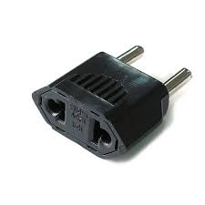
Adapters and the Adapter Design Pattern
The doubly linked list (DLinkedList class) could be adapted to implement a deque
Except for keeping track of the number of elements in the deque, one can simply map each deque method to a corresponding DLinkedList method
For example: insertFront() corresponds to addFront()

Slide 78
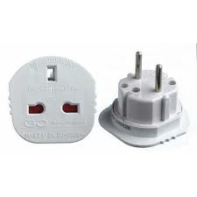
Adapters (Wrapper)
A class that translates one interface to another

Slide 79
Mapping – Stack/Deque
Stack Method | Deque Implementation
size() | size()
empty() | empty()
top() | front()
push(o) | insertFront(o)
pop() | eraseFront()
Implementing a stack with a deque

Slide 80
Mapping – Queue/Deque
Queue Method | Deque Implementation
size() | size()
empty() | empty()
front() | front()
enqueue(e) | insertBack(e)
dequeue() | eraseFront()
Implementing a queue with a deque

Slide 81
Implementation of a Stack by Means of a Deque
typedef string Elem; // element type
class DequeStack { // stack as a deque
public:
DequeStack(); // constructor
int size() const; // number of elements
bool empty() const; // is the stack empty?
const Elem& top() const throw(StackEmpty); // the top element
void push(const Elem& e); // push element onto stack
void pop() throw(StackEmpty); // pop the stack
private:
LinkedDeque D; // deque of elements
};
Code fragment 5.23 (Adapter Design Pattern)

Slide 82
Implementation of a Stack by Means of a Deque – 2
DequeStack::DequeStack() // constructor
: D() { }
// number of elements
int DequeStack::size() const
{ return D.size(); }
// is the stack empty?
bool DequeStack::empty() const
{ return D.empty(); }
// the top element
const Elem& DequeStack::top() const throw(StackEmpty) {
if (empty())
throw StackEmpty("top of empty stack");
return D.front();
}
Code fragment 5.24

Slide 83
Implementation of a Stack by Means of a Deque – 3
// push element onto stack
void DequeStack::push(const Elem& e)
{ D.insertFront(e); }
// pop the stack
void DequeStack::pop() throw(StackEmpty)
{
if (empty())
throw StackEmpty("pop of empty stack");
D.removeFront();
}
Code fragment 5.24

